Slide 1
Wisconsin Workforce Outlook
Creative Hiring Strategies
in
Manufacturing
May 7, 2019
Fond du Lac, WI
Dennis K. Winters
Chief Economist
Wisconsin Department of Workforce Development

Slide 2
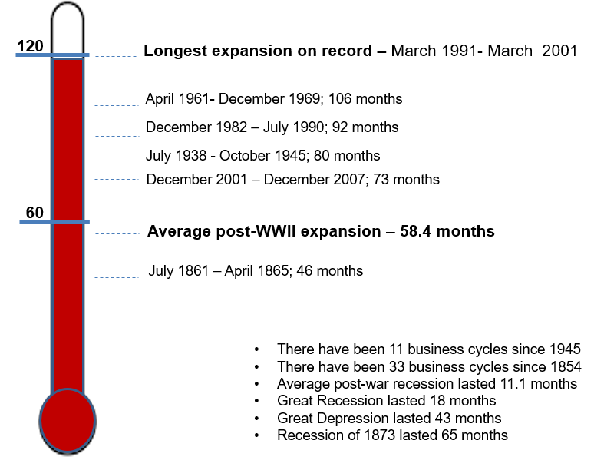
Current expansion; July 2009 - ? 119 months (May)
Months

Slide 3
Economic Outlook
Employment
Source: Bureau of Labor Statistics, LMI, OEA

Slide 4
Economic Outlook
Unemployment Rate
Source: Bureau of Labor Statistics, LMI, OEA

Slide 5
Unemployment Rate
Source: Local Area Unemployment Statistics (LAUS), Bureau of Labor Statistics (BLS)

Slide 6
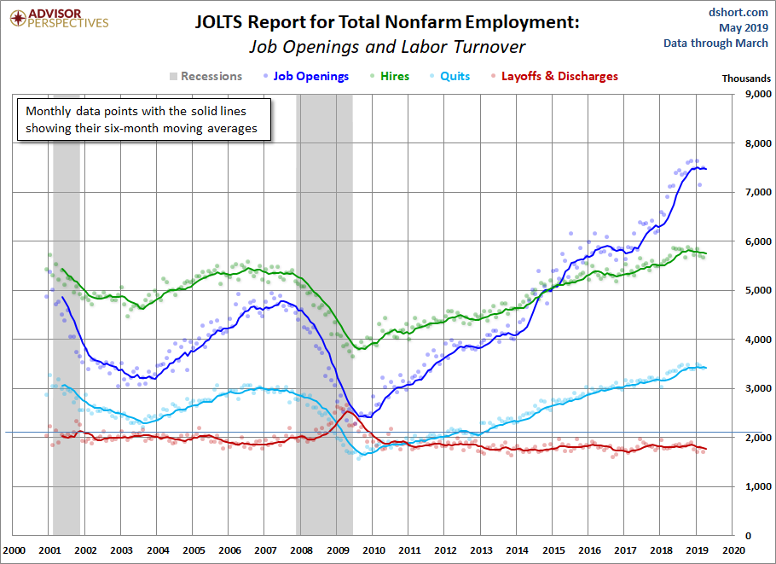
How Employment is Tracking

Slide 7
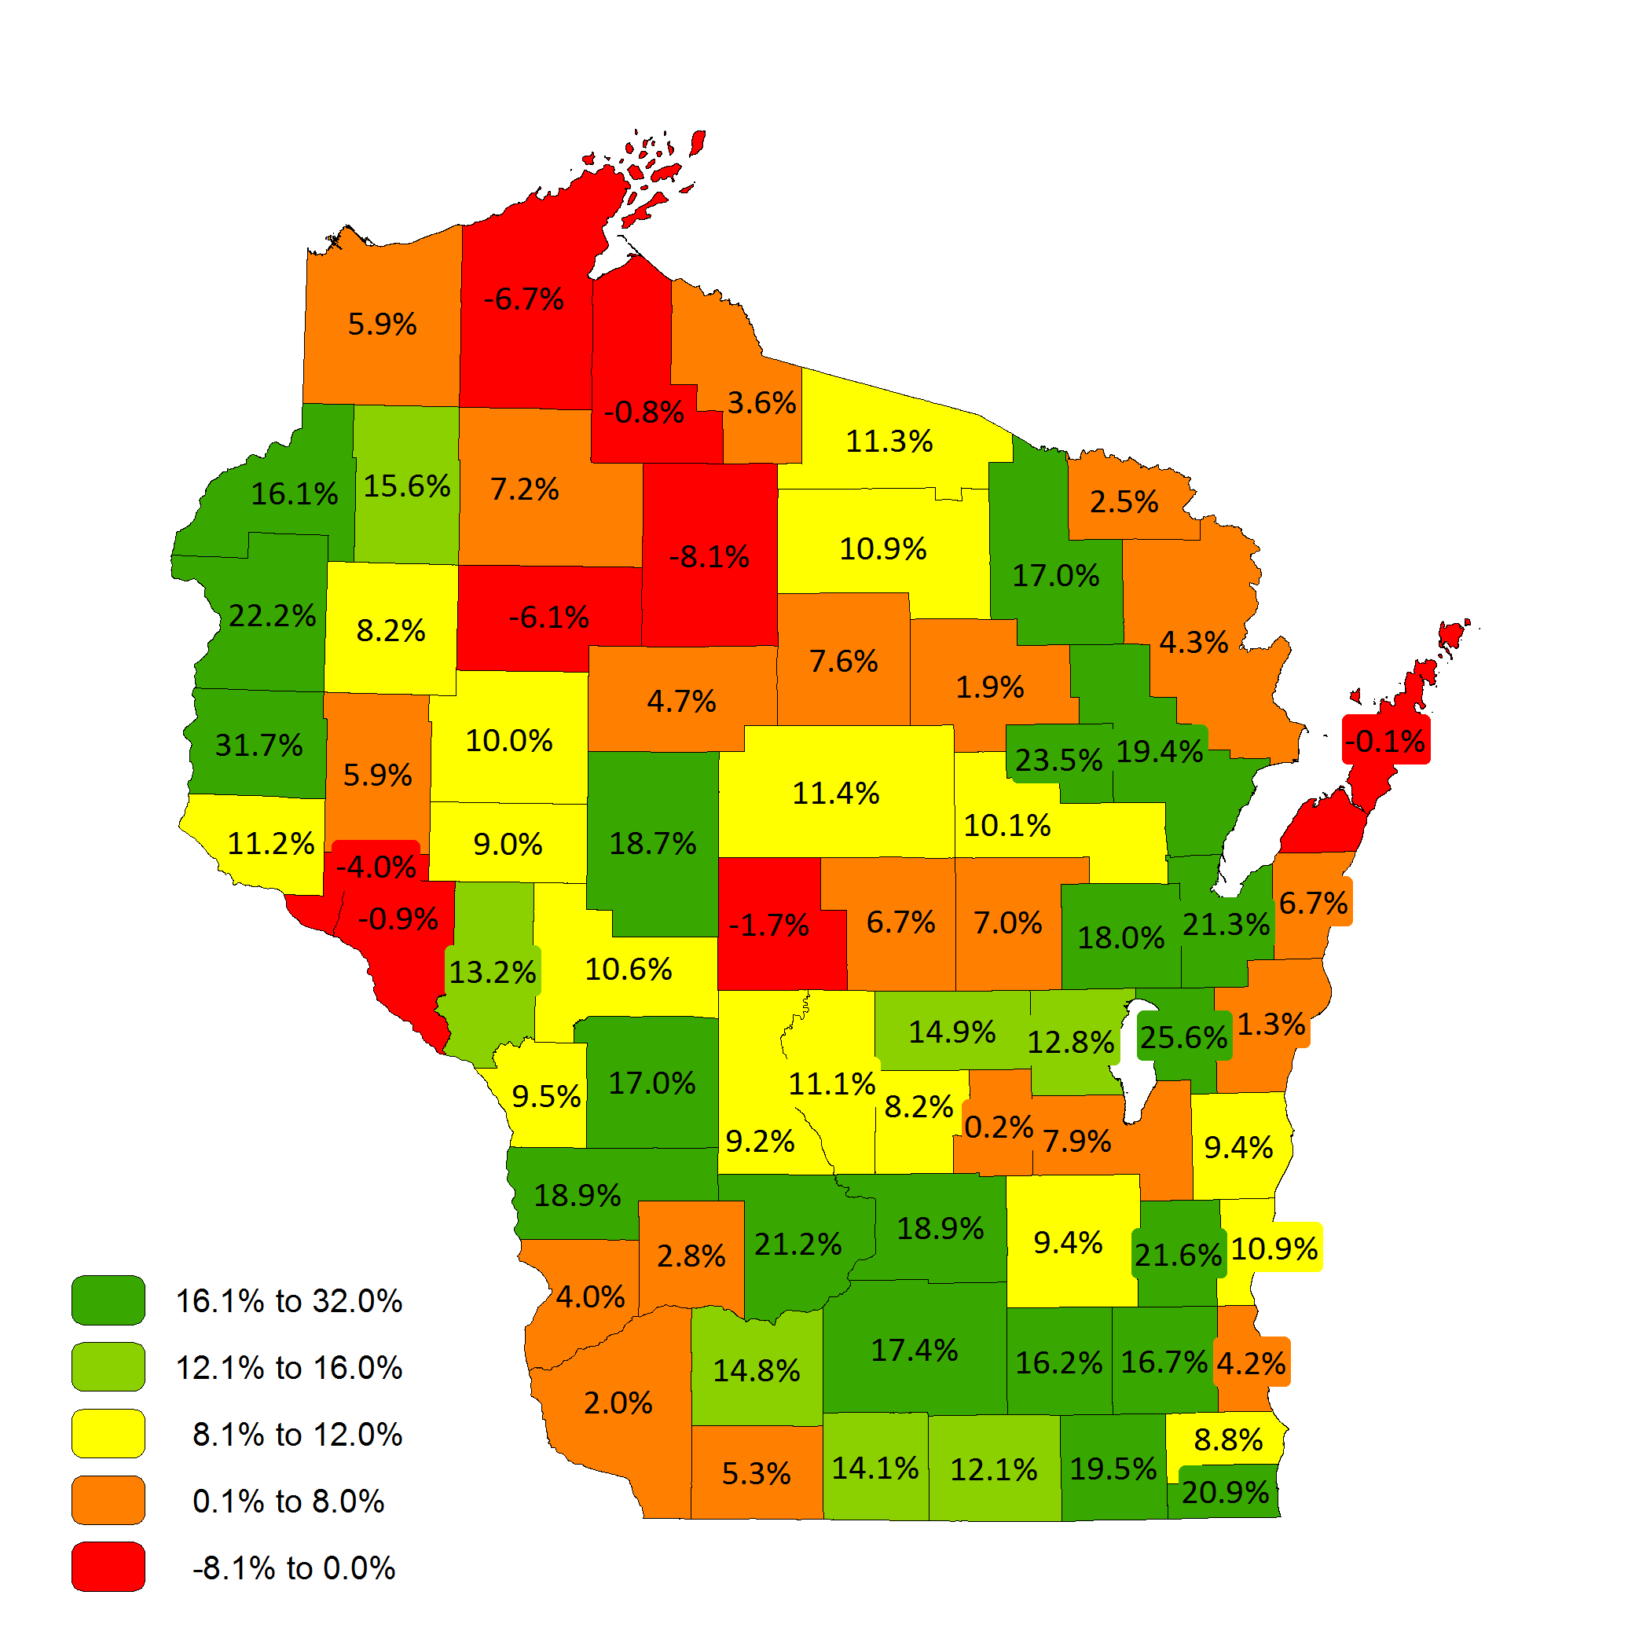
Projected Population Change
2015 - 2035
Source: WI Dept. of Administration Demographic Services Center and U.W.-Madison Applied Population Lab

Slide 8
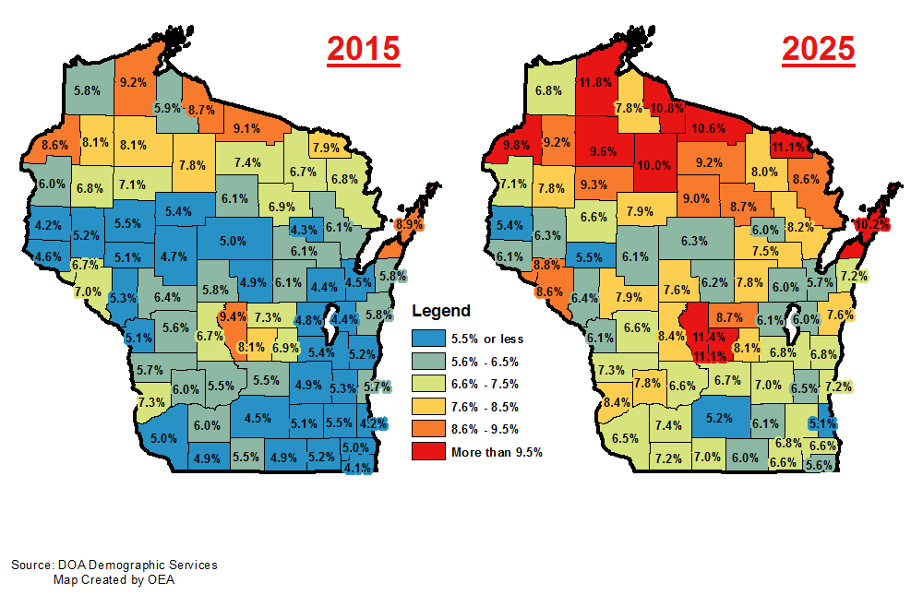
Projected Population Change 2015 – 2025
People Aged 65 & Older

Slide 9
Wisconsin’s Workforce Growth
The New Economy
Source: Bureau of Labor Statistics, OEA
Notes:
WISCONSIN’S WORKFORCE GROWTH BECOMES FLAT

Slide 10
Labor Market Participation
Source: Bureau of Labor Statistics, OEA

Slide 11
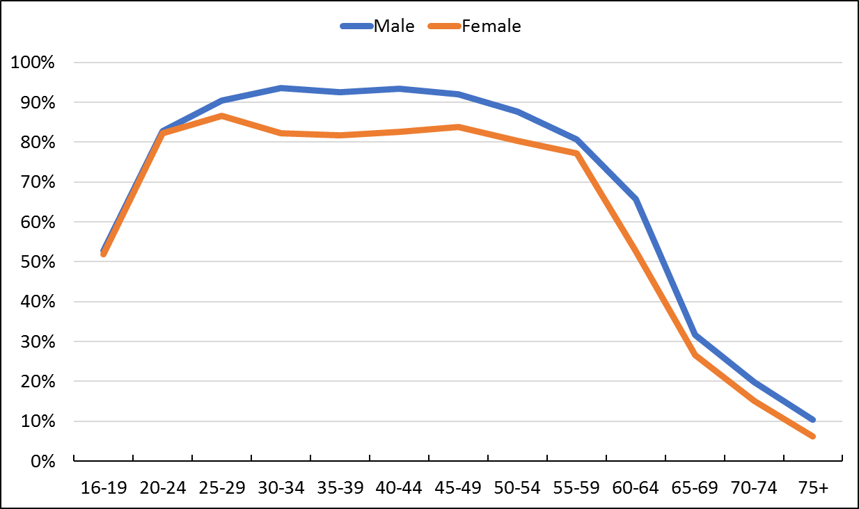
Labor Force Participation Rate (LFPR)
Wisconsin LFPR by Age Cohort
Source: 2016 American Community Survey (ACS), US Census; sourced from IPUMS.org

Slide 12
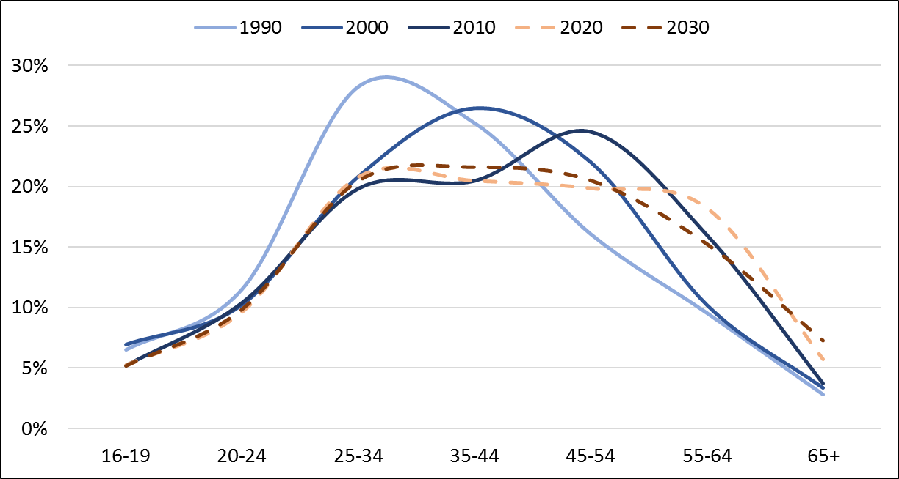
Wisconsin Labor Force
Percent of Wisconsin Labor Force by Age Group
Source: US Census Bureau, sourced from IPUMS.org;
WI DOA Population Projections with OEA Calculations

Slide 13
Local Demographics - Age
Source: Quarterly Workforce Indicators (QWI), US Census Bureau LEHD

Slide 14
Local Manufacturing Employment
Source: Quarterly Census of Employment and Wages (QCEW), Bureau of Labor Statistics (BLS)

Slide 15
Wisconsin Labor Market

Slide 16
Wisconsin Labor Market

Slide 17
Wisconsin Labor Market

Slide 18
Local Demographics - Gender and Race/Ethnicity
Gender (%)
 | Male | Female
Overall Labor Force | 52.8% | 47.2%
Manufacturing Industry | 70.9% | 29.1%
Race/Ethnicity (%)
 | White | Hispanic or Latino | Black or African American
Overall Labor Force | 92.4% | 3.8% | 0.2%
Manufacturing Industry | 91.0% | 4.3% | 0.0%
“Labor Force” includes employed and unemployed. “Manufacturing Industry” includes employed. “White” refers to White Non-Hispanic.
Includes Winnebago, Fond du Lac, and Calumet Counties
Source: IPUMS Online Data Analysis System (2017 1-YR American Community Survey); IPUMS-USA, University of Minnesota, www.ipums.org

Slide 19
Fox Valley Production – Projected Openings

Slide 20
Propensity for Automation by Occupational Group
Source: The Future of Employment: How Susceptible are Jobs to Computerisation, C.B. Frey and M.A. Osborne, September 17, 2013,
Oxford Martin School, University of Oxford; OES.

Slide 21
Propensity for Automation by Region
Source: The Future of Employment: How Susceptible are Jobs to Computerisation, C.B. Frey and M.A. Osborne, September 17, 2013,
Oxford Martin School, University of Oxford; OES.

Slide 22
Propensity for Automation by Median Hourly Wage
Source: The Future of Employment: How Susceptible are Jobs to Computerisation, C.B. Frey and M.A. Osborne, September 17, 2013,
Oxford Martin School, University of Oxford; OES.

Slide 23
Propensity for Automation by Typical Educational Requirements
Source: The Future of Employment: How Susceptible are Jobs to Computerisation, C.B. Frey and M.A. Osborne, September 17, 2013,
Oxford Martin School, University of Oxford; OES.

Slide 24
Questions?
Dennis.Winters@dwd.Wisconsin.gov
Notes:
- Questions?

